Slide 1

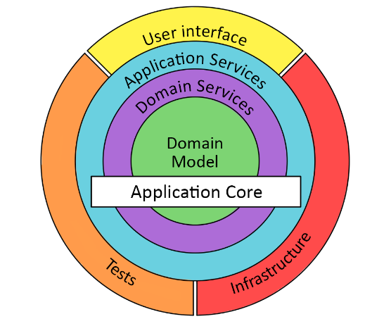
Onion Arquitecture
Notes:
, how and why the agile manifesto was created, and its principles and values

Slide 2
What is Onion Arquitecture
It provides a solution for common problems. Onion architecture layers interact to each other by using the Interfaces. It is based on the inversion of control principle.
The architecture does not depend on the data layer as in classic multi-tier architectures, but on the actual domain models
Notes:
Its not a methodology, specifyc way to developing software, a framework or a process

Slide 3
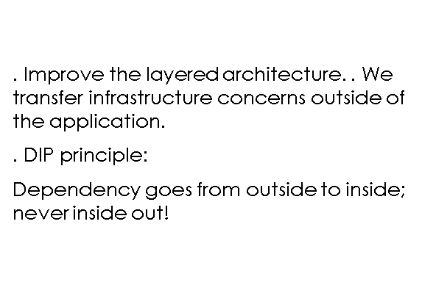
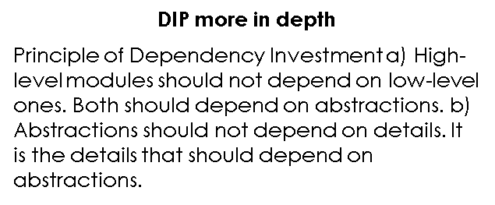
An evolved multitier structure
Notes:
Its not a methodology, specifyc way to developing software, a framework or a process

Slide 4
Pros
Cons
Interface Soup
Lots of interfaces for interaction with the core which can make navigating a project tougher
Core heavy
Lots of logic and movement in the core, any changes made inside the core could affect behaviour outwards
Flexibility
the outer layer is completely decoupled from application logic
Prioritised/one way coupling
the most important code depends on nothing
Clear Dependency rules
enforces clear rules on where each mechanism sits and what it relies on
Notes:
1. The idea is to get a working product in the hands of customers as soon as possible. support it. The best ways to ensure you make customers happy while continuously delivering valuable software are to ship early, iterate frequently, and listen to your market continually. Instead of releasing a “finished” product, iterations continue to make incremental improvements to product based on customer and market feedback. 2. Its more important to change the requierement and don’t follow an strict plan because this we ll more useful for the customer. Previous approaches to product development were often change adverse; detailed, well-documented plans were made before development began and were set in stone regardless of new findings. When actionable insight is uncovered, plans are adjusted to better serve customer and business needs. 3. Delivering software frequently we'll keep the costumer informed about the job done. Agile development cycles, often called “sprints” or “iterations” break down product initiatives into smaller chunks that can be completed in a set timeframe.

Slide 5
Layers
Domain Model
Domain Services
Application Services
UI / infrastrucure / tests
Notes:
Its not a methodology, specifyc way to developing software, a framework or a process

Slide 6
Layers
Domain Model
Center of the arquitecture. Contains all the entities. This layer doesn't have dependencies
Domain Services
Define the interfaces needed that allow to store and recover objects
Notes:
Its not that we don’t have to care about comprehensive documention for example, but by the end of the day we have to care more about working software over comprehensive doc

Slide 7
Layers
Applications Services
The Service layer holds interfaces with common operations, such as Add, Save, Edit, and Delete. Also, this layer is used to communicate between the UI layer and repository layer
UI / infrastrucure / tests
For a Web application, it represents the Web API or Unit Test project. This layer has an implementation of the dependency injection principle so that the application builds a loosely coupled structure and can communicate to the internal layer via interfaces
Notes:
Its not that we don’t have to care about comprehensive documention for example, but by the end of the day we have to care more about working software over comprehensive doc

Slide 8
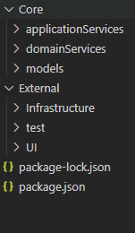
Folder Structure
Notes:
Its not that we don’t have to care about comprehensive documention for example, but by the end of the day we have to care more about working software over comprehensive doc

Slide 9
Diagram
Notes:
Its not a methodology, specifyc way to developing software, a framework or a process

Slide 10
References
Onion Architecture: Definition, Principles & Benefits | CodeGuru
Domain Driven Design - Onion Architecture in 2 Minutes - YouTube
Onion Architecture Without the Tears – Brendan Richards - YouTube
Onion Architecture - Cutting onions, without the tears! (ovoenergy.com)

